Slide 1


HUMAN FACIAL EXPRESSION RECOGNITION USING CONVOLUTIONAL NEURAL NETWORKS
A NEELIMA DEVI 160618733122 AMMANOLLA SHIRISHA 160618733127
ANNAREDDY GNANA PRASOONA 160618733130
PROJECT GUIDE : Mr L. THIRUPATHI

Slide 2
INTRODUCTION
Domain:
Artificial intelligence
Machine Learning
Deep learning
Convolutional Neural Network (CNN) :
Convolutional Neural Networks are a type of Deep Learning Algorithm .

Slide 3
OBJECTIVE
The objective of this project is to classify image into seven different expression classes such as : Anger, Disgust , Fear, Happy, Sad, Surprise and Neutral.
SCOPE
Highly sensitive to pose variations.
Proper centered face is required .
Front view of the face is required .
Recognizes only human facial expressions.

Slide 4

EXISTING SYSTEM
Ekman and Friesen - Facial Action Coding System (FACS)(2000)
Yamada - new architecture of hidden Markov models(2015)
Zhang - Scale-Invariant feature transform (SITF)(2005)
Shan - Local Binary Patterns(2011)

Slide 5

PROPOSED SYSTEM
The proposed system provides an alternative scheme for human emotion recognition from facial images, using convolutional neural networks , which is a specialized type of neural network model designed for working with two-dimensional image data.

Slide 6

SOFTWARE REQUIREMENTS
We have used Anaconda for Python 3.6.5 and Spyder.
Operating System : Microsoft Windows 10
HARDWARE REQUIREMENTS
Processor : Intel CORE i7 processor with minimum 2.9 GHz speed.
RAM : Minimum 4 GB.
Hard Disk : Minimum 500 GB
GB

Slide 7

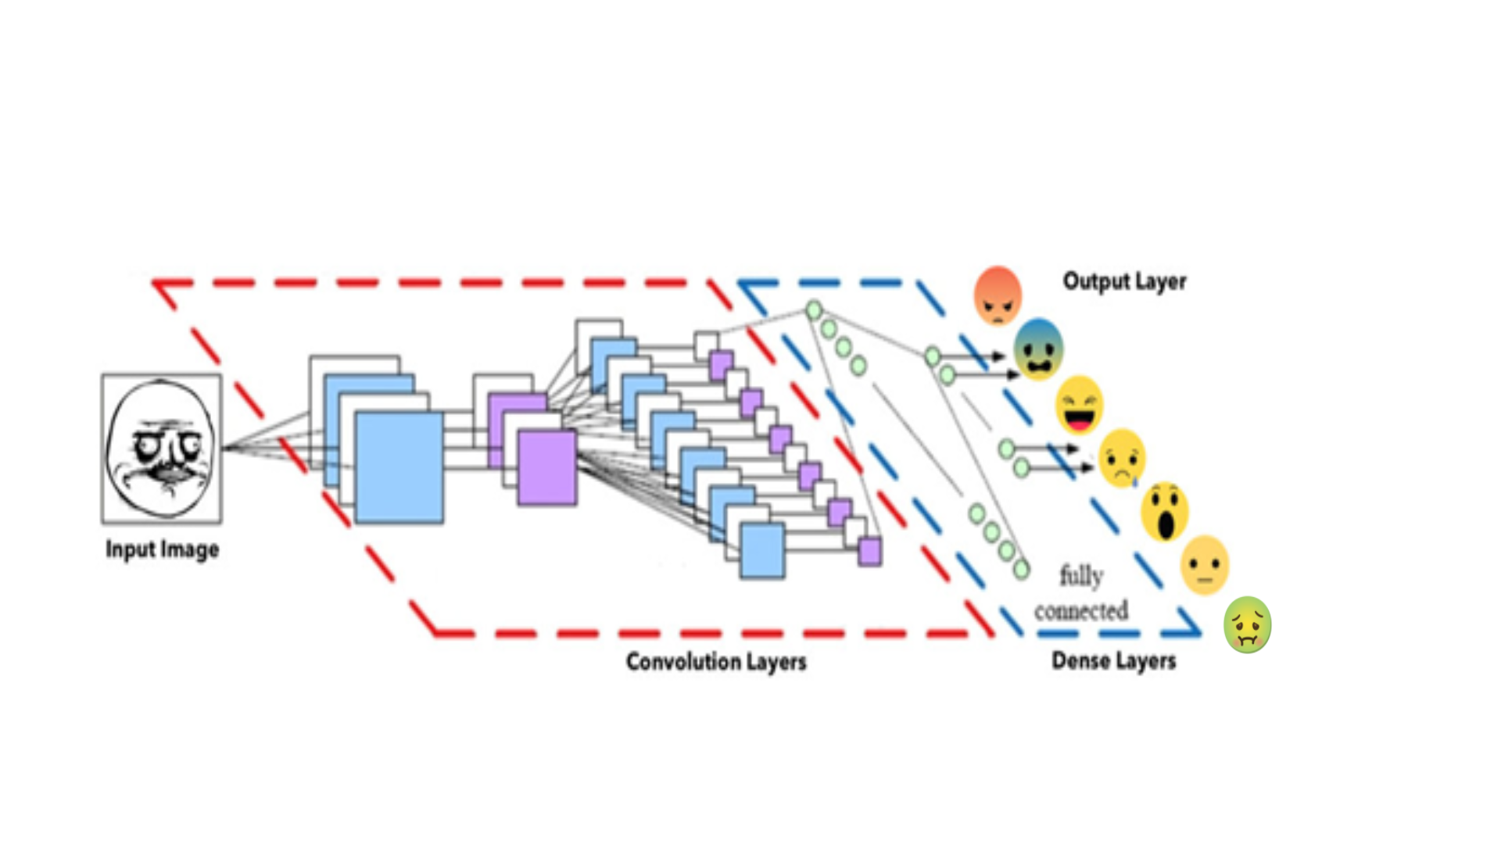
ARCHITECTURE OF CONVOLUTIONAL NEURAL NETWORK
Convolutional Layer
Pooling Layer
Fully Connected Layer

Slide 8

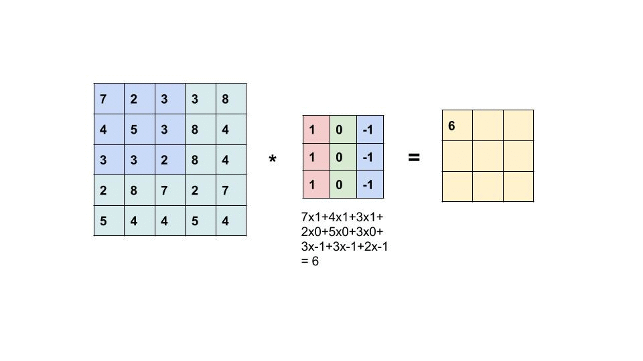
Convolutional Layer :
The filter slides over the input to generate feature map.
Input
Filter
Feature Map

Slide 9
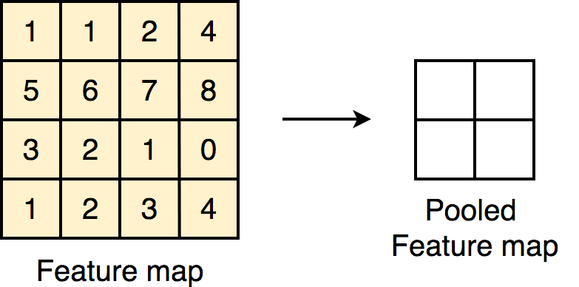
Pooling Layer :
Max Pooling
Max pooling

Slide 10
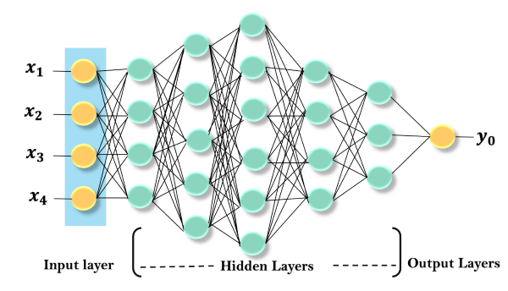
Fully Connected Layer
The input layer receives input data.
The hidden layers perform mathematical operations on inputs.
The output layer returns the output to the user.

Slide 11

SAMPLE CODE

Slide 12
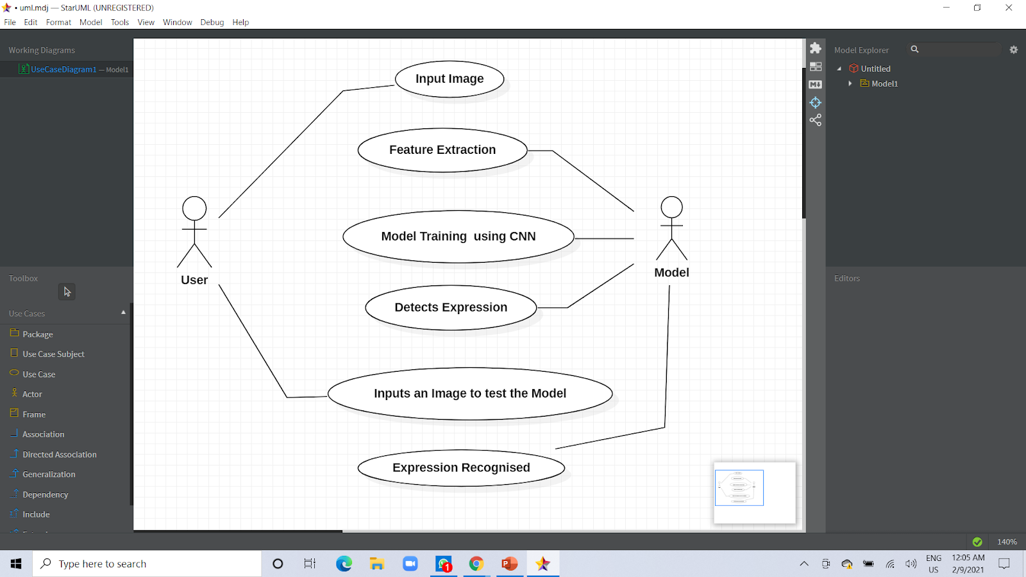
USE CASE DIAGRAM FOR HUMAN FACIAL EXPRESSION RECOGNITION

Slide 13

TESTING

Slide 14
S. No | Test case scenario | Test case Description | View | Expected output | Actual output | Status
1 | Human Face | The image is in .jpg format, This image contains picture of a lady in mid 30's and the expression on her face is "Angry" | Front view | Angry | Angry | Passed
2 | Human Face | The image is in .jpeg format, This image contains picture of a man in 60's and the expression on his face is "Happy" | side view | Happy | Neutral | Failed
3 | Human Face | The image is in .jpg format, This image contains picture of a girl and the expression on her face is "Sad" | Front view | Sad | Sad | Passed

Slide 15
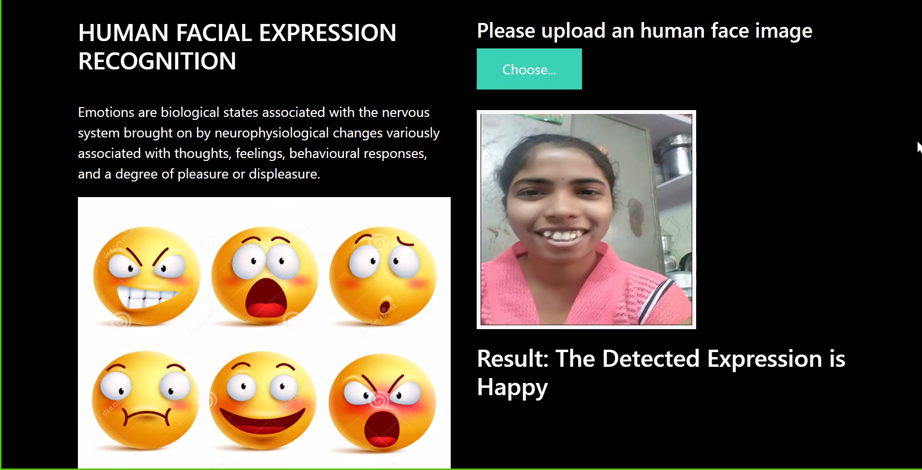
OUTPUT SCREENS

Slide 16
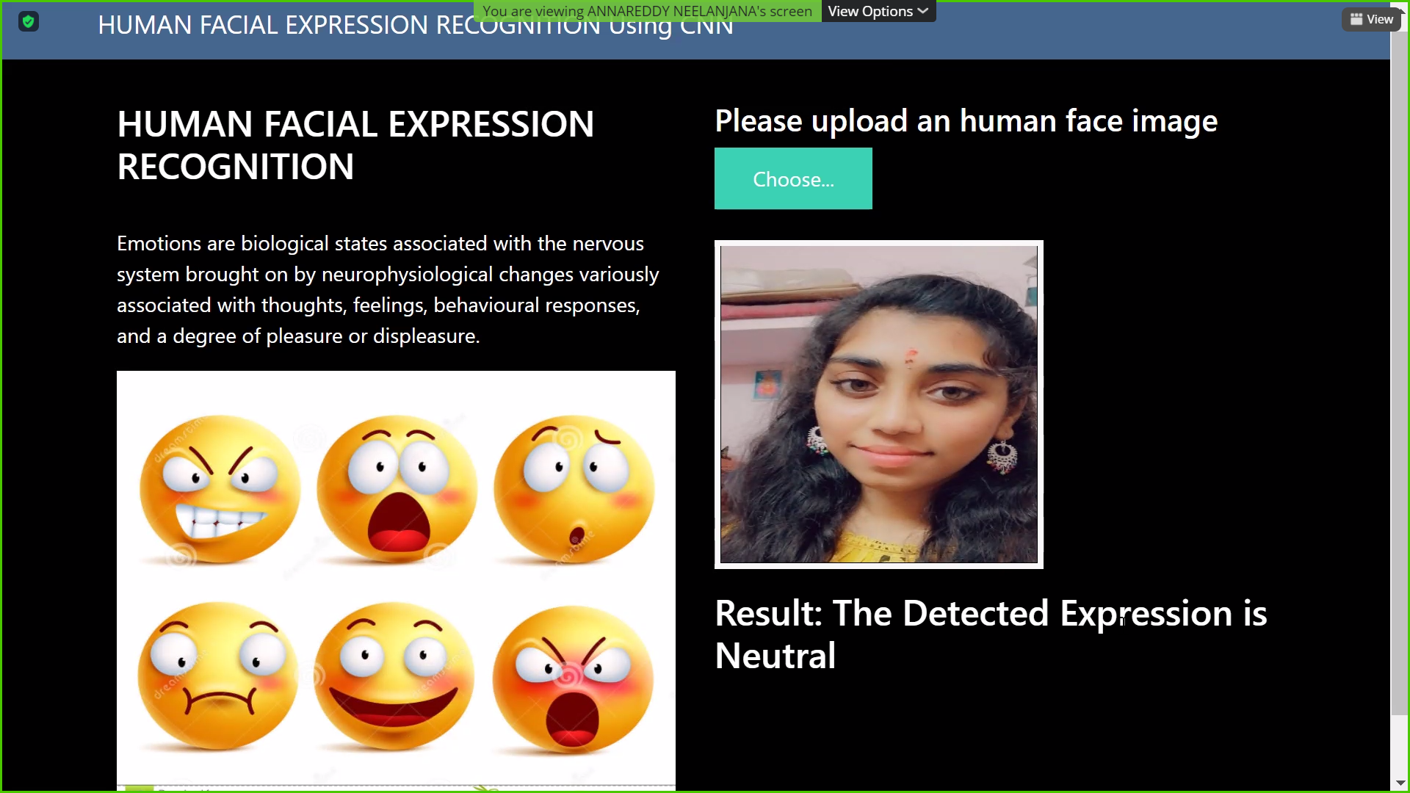

Slide 17
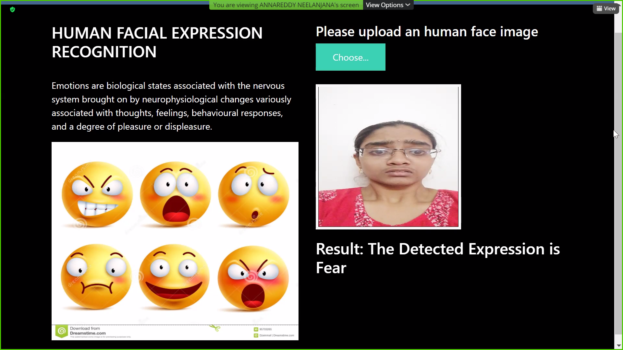

Slide 18
CONCLUSION
Efficient machine - human interaction.
Machines can understand human emotions and act accordingly.
Need for the generation.

Slide 19
FUTURE ENHANCEMENTS
Model can be trained in different Views
Video Analysis
Clever Marketing
Track a user‘s state of mind to offer relevant information

Slide 20
REFERENCES
1] AI- javatpoint.com/artificial-intelligence-tutorial
[2] ML-w3schools. com/python/python_Ml_getting_started.asp
[3] P. Ekman and W. V. Friesen. Emotional facial action coding system. Unpublished manuscript, University of California at San Francisco, (2000) .
[4] Yamada Yaminan,Applying artificial neural networks for face recognition. Advances in Artificial Neural Systems, (2015).
[5] Zhang et al. extracted Scale-Invariant feature transform (SITF) and used the Deep neural network (DNN) as the classifier.(2005).
[6] Shan Caifeng -IEEE Transactions on Systems Man and Cybernetics Part C (Applications and Reviews) Local Binary Patterns and Its Application to Facial Image Analysis (2011).

Slide 21
THANK YOU

